Slide 1
The EEAS and the EU’s foreign policy machinery
Dr. Caterina Carta
Université Laval
Notes:
We go to Brussels, we negotiate and sign some stirring paragraphs on common foreign and defence policy, and come home satisfied that we have achieved something—without recognising that if we and others do nothing to implement what has been agreed, nothing will happen.
Enlargement itself has made coherence more difficult, in a field in which national governments and national capabilities remain key to the authorisation of common action. It is far more difficult to generate agreement among 26–28 foreign ministers than 9 or 12.
Smaller states have narrower sets of interests—as visits I made when in government to the capitals of some smaller states brought home vividly. Baltic member states, for understandable reasons of perspective, attach far lower priority to North Africa than to Russia, and Mediterranean states take the opposite view.
In the federal United States, the executive clout of Washington imposes foreign policy priorities on 50 diverse states. The EU, however, is a weak confederation, in which national capitals retain their own international perspectives and national interests, and national debates are separated by different languages and the distinctive narratives of national media.

Slide 2
Outline
Look at some questions into more details: What is EU foreign policy? And Diplomacy?
Glance into the EU Policy Making machinery;
Introduce the main institutional (executive) actors and their role in the FP policy cycle;
Discuss the main institutional and organizational problems introduced by the Lisbon Treaty;
Define the EU FP as “Single in a name, dual in policy-making; multiple in nature” (Keukeleire and Delreux, 2014: 61).
Notes:
CFSP instruments;

Slide 3
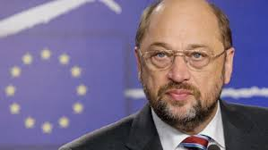
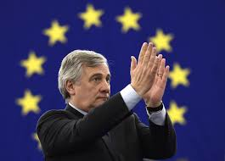
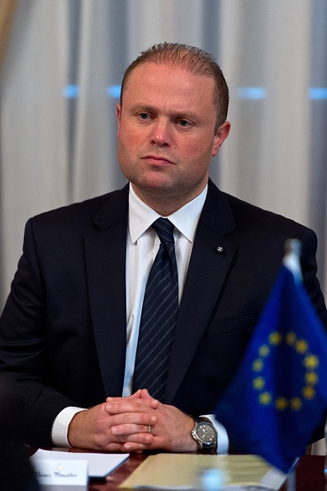
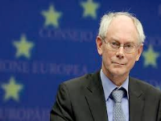
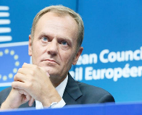
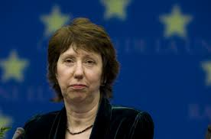
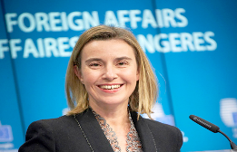
Let’s warm up!
Succeeded the Slovakian Presidency, precedes the Estonian
Notes:
http://www.canalplus.fr/c-emissions/c-le-petit-journal/pid6515-le-petit-journal.html?vid=1268412
4.38

Slide 4
Agency in FP
Presence and Actorness (Sjösted)
Agency: “individuals taking decisions and implementing them on behalf of entities which possess varying degrees of coherence, organization and power” (Hill, 2003)
Challenges:
Individual actors;
Decision-making;
Implementation;
Coherence — at the EU level.
Notes:
availability of policy-instruments + willingness & ability to use them
Objectives and perspective: EU foreign policies seek to promote international development, multilateralism, environmentalism, democracy, diplomacy, and peace, while its internal policies pursue deeper integration, enlargement of membership, cooperation, the benefits of a common market, and so on.
It is difficult to find appropriate criteria against which to assess the record of the EU and its member states in managing the unstable regions around its borders over the past 25years. The EU is not a federation, but the rhetoric of its leaders over the years has suggested that a common foreign policy, comparable to that of a federal state, was within its grasp. The extension of membership, economic prosperity, political stability and democratic values across east-central Europe, much of south-east Europe and the Baltic states has been a clear success, in spite of continuing problems over political liberties and corruption in some new members. Stabilisation, conflict prevention and resolution across the weak states of Africa have attracted much money and technical assistance, with mixed success, although some would argue that the problems African societies faced in terms of population rise and rapid social and economic transformation were intractable. States such as Eritrea, from which nearly one-third of the migrants (or refugees) trafficked across the Mediterranean in 2013– 2014 came, have continued to fester without active EU engagement. Conflict within Sudan—continuing after the granting of independence because of overlapping conflicts within Sudan and Southern Sudan—has persisted throughout a long succession of UN, EU and other interventions.

Slide 5
Institutional Actors
The European Council and its President
Council of the EU
Presidency of the Council of the EU
High Rep/EEAS/Delegations
European Commission
EP
ECJ
CEPS
Notes:
EP Limited role in CFSP and strong activism;
Budgetary powers and power in the the adoption of international agreements (consent and veto power);
Several committees for external affairs (e.g. Committee on Foreign Affairs; on Security and Defence, etc);
Inter-parliamentary dialogues.
ECJ Quasi-general jurisdiction over all policy areas (e.g. trade, development, environment…).
CFSP is an exception (art. 24 TUE): no control over the legality of CFSP acts.
2 derogations: 1) monitor the principle that implementation of the CFSP does not affect the exercise of other EU’s competences; 2) rule on proceeding reviewing the legality of decisions of the Council that provide for economic or financial sanctions against natural or legal persons (275 TFEU)

Slide 6
What is foreign policy?
A “goal- or problem-oriented program by authoritative policymakers directed toward entities outside the policymakers' political jurisdiction” (Hermann, 1990).
“The sum of official external relations conducted by an independent actor (usually a state) in international relations” (Hill, 2003).
So, how many policy-fields?
How many Ministries involved in the making of “programs directed towards foreign entities?

Slide 7
What is EU FP?
The EU foreign policy is part of a political system (Jørgensen, 1993)
With inputs from national actors and from external sources; and with the outputs or foreign policy actions and positions” (Ginsberg, 2001).
“A collective enterprise which allows its members to pursue partly common partly separated international actions” (Hill, 1996).
Notes:
and their preferences

Slide 8
(EU) Diplomacy
A method of international interaction and the techniques used to carry out political relations across international boundaries (Plischke, 1979).
PD: The way in which government and private individuals influence public attitudes which bear on another government’s FP decisions (Signitzer & Coombs, 1992).
The EU’s PD is complicated by the imprecise nature of its actorness: the EU as an ongoing project and the EU in existential crisis (Duke16).
Notes:
Diplomacy is a function of foreign policy
“Foreign policy is the content of foreign relations” (Kleiner, 2008).
If the external audience finds these norms to be attractive, the pop- ulation’s government is more likely to respond through its policies towards the originator country in a positive way.
If the external audience does not understand the narrative, or finds the norms to be unattractive, then its government is less likely to respond with favorable policies.
cultural and language diversity is important and should be protected
foreign policy should involve multilateralism whenever possible (especially if it also serves national interest)
human rights must be promoted globally, even if their protection requires the use of force
environmental sustainability should be pursued even at the cost of profit margins
education is a fundamental right and provides solution to many social ills
development leads to security
Europeans should help other regions with their cooperation or inte-
gration efforts
it is the duty of the state to provide welfare to citizens
EU integration is intended to benefit all Europeans and ensures
peace in the region
As Duke writes, the EU’s public diplomacy:
[. . .] is about self-image, or the image that a given actor intends to project to a third party. The EU’s PD [public diplomacy] is complicated by the imprecise nature of the EU’s overall actorness or, put more simply, the type of actor the EU wishes to become on the international stage. This is in part due to the fact that the EU is an ongoing project, lacking finalité, but may also lie in a broader post–Cold War existential crisis about who and what the EU is on the global stage.
The East StratCom Task Force is significantly improving the positive communication of EU policies towards the Eastern Partnership countries, whilst addressing disinformation activities, including through improving the resilience of media. Outreach efforts such as the “Stronger Together” campaign in Ukraine have reached a large audience, highlighting the concrete benefits of partnership with the EU and supporting the reform agenda.

Slide 9
Global strategy
Priorities?
Security (military, counter-terrorism, cyber; energy) and
Resilience (at home and in the neighborhood)
Integrated/Comprehensive Approach (Strategic Communication, immigration policy, Conflicts)
Values and Interests?
Peace & Security; Prosperity; Democracy; Rule-based global order; IPE of peace, Cooperative regional order; Global governance.
What kind of narrative?
Principled Pragmatism: a new narrative for the EU
What does it mean “Global” Strategy? How to implement it?
“not just intended in a geographical sense: it also refers to the wide array of policies and instruments the Strategy promotes”: A “Joined-Up Europe” (p. 48)
Undertaking a multi-dimensional approach through the use of all available policies and instruments is essential.
Notes:
p. 4 Global” is not just intended in a geographical sense: it also refers to the wide array of policies and instruments the Strategy promotes. It focuses on military capabilities and anti-terrorism as much as on job opportunities, inclusive societies and human rights. It deals with peace-building and the resilience of States and societies, in and around Europe. The European Union has always prided itself on its soft power – and it will keep doing so, because we are the best in this field. However, the idea that Europe is an exclusively “civilian power” does not do justice to an evolving reality. For instance, the European Union currently deploys seventeen military and civilian operations, with thousands of men and women serving under the European flag for peace and security – our own security, and our partners’. For Europe, soft and hard power go hand in hand.
P. 27 Echoing the Sustainable Development Goals, the EU will adopt a joined-up approach to its humanitarian, development, migration, trade, investment, infrastructure, education, health and research policies, as well as improve horizontal coherence between the EU and its Member States.
IMPLEMENTATION - https://europa.eu/globalstrategy/sites/globalstrategy/files/full_brochure_year_1.pdf

Slide 10
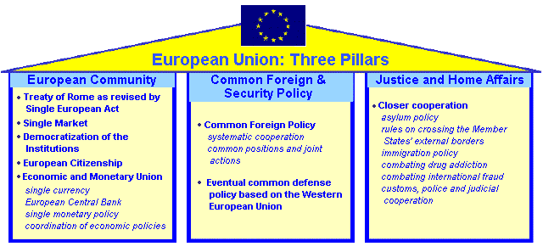
Institutional framework
A narrow definition of foreign policy: “high politics” detached from external “low” policies.
The Community and the Union (intergovernmental) methods (Smith, 1996): a way of preserving “the heart of the artichoke”;
Lisbon abolishes the pillar structure, but CFSP is “subject to specific rules and procedures”.
Notes:
we see policies being made (and administered) between a myriad of interconnecting, interpenetrating organisations. It is the relationship involved in committees, the policy community of departments and groups, the practices of cooption and the consensual style, that perhaps better account for policy outcomes. Richardson, 1996

Slide 11
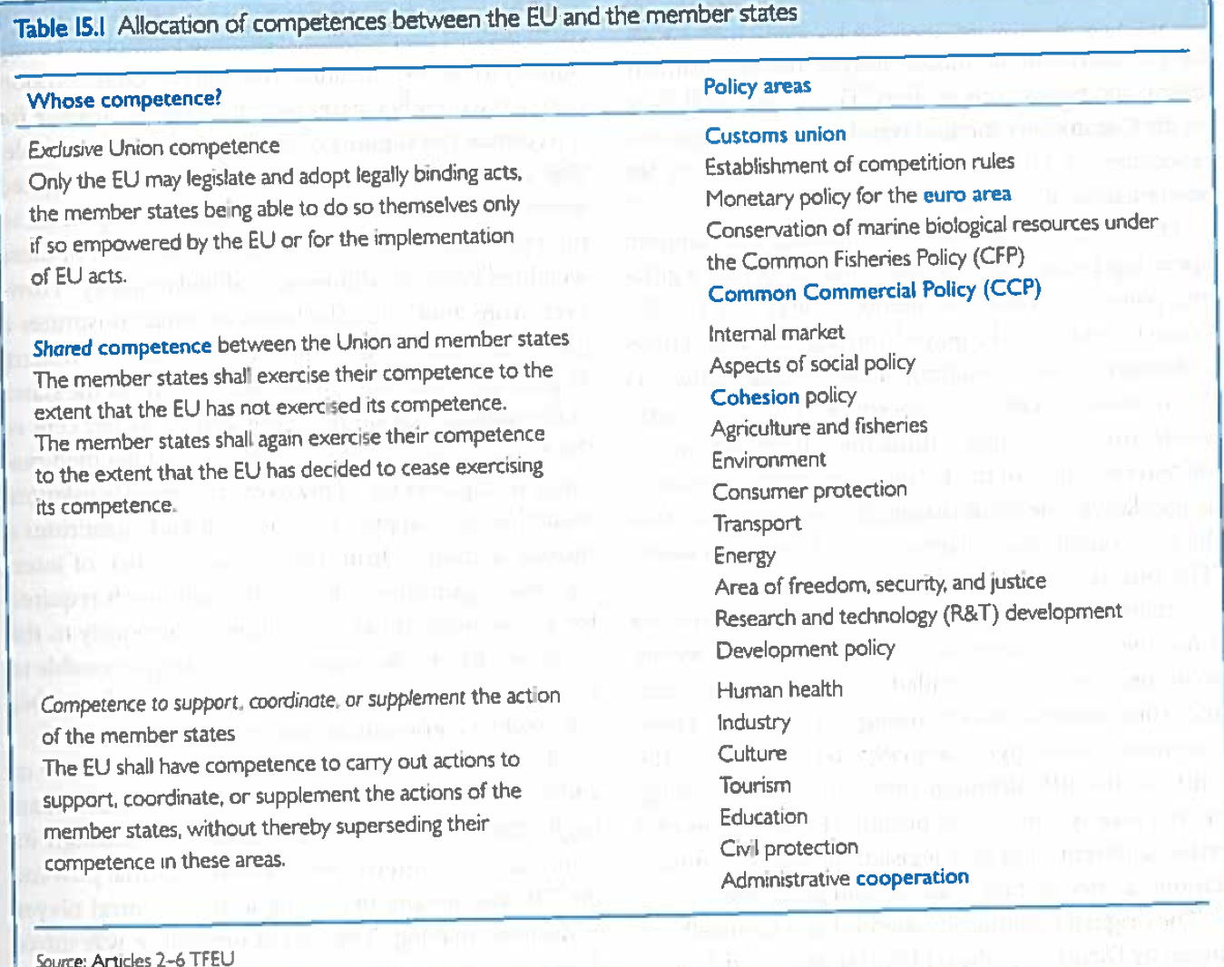
Competences
Three general categories + CFSP:
Exclusive – Only the EU can adopt legally binding acts (e.g. CCP);
Shared – The EU and the MSs can adopt legally binding acts, but the MSs can exercise their competence if the EU has not yet exercised its own (environment); the EU competence does not prevent the MSs to pursue national policies (development);
Supporting – EU has supporting/coordination competences (culture).

Slide 12
CFSP - Competences
1. The EU’s competence covers “all areas of foreign policy and questions relating to its security […]”. The CFSP is defined and implemented by the European Council and the Council acting unanimously […]. The adoption of legislative acts is excluded.
2. The EU conducts, defines and implements a CFSP, based on mutual political solidarity among the MSs…
3. The MSs shall support the EU’s external and security policy in a spirit of loyalty and mutual solidarity […] They shall refrain from any action which is contrary to the interests of the Union.
Notes:
1. The Union's competence in matters of common foreign and security policy shall cover all areas of foreign policy and all questions relating to the Union's security, including the progressive framing of a common defence policy that might lead to a common defence. The common foreign and security policy is subject to specific rules and procedures. It shall be defined and implemented by the European Council and the Council acting unanimously, except where the Treaties provide otherwise. The adoption of legislative acts shall be excluded. The common foreign and security policy shall be put into effect by the High Representative of the Union for Foreign Affairs and Security Policy and by Member States, in accordance with the Treaties. The specific role of the European Parliament and of the Commission in this area is defined by the Treaties. The Court of Justice of the European Union shall not have jurisdiction with respect to these provisions, with the exception of its jurisdiction to monitor compliance with Article 40 of this Treaty and to review the legality of certain decisions as provided for by the second paragraph of Article 275 of the Treaty on the Functioning of the European Union. 2. Within the framework of the principles and objectives of its external action, the Union shall conduct, define and implement a common foreign and security policy, based on the development of mutual political solidarity among Member States, the identification of questions of general interest and the achievement of an ever-increasing degree of convergence of Member States' actions. 3. The Member States shall support the Union's external and security policy actively and unreservedly in a spirit of loyalty and mutual solidarity and shall comply with the Union's action in this area. The Member States shall work together to enhance and develop their mutual political solidarity. They shall refrain from any action which is contrary to the interests of the Union or likely to impair its effectiveness as a cohesive force in international relations. The Council and the High Representative shall ensure compliance with these principles.

Slide 13
Lisbon and external action
Still divided foreign and external policy fields;
A new arrangement involving all institutions:
A new permanent President of the European Council;
A reorganization of the Council of the EU;
Creation of a new “Quasi-Foreign Ministry” (the EEAS);
“Sectoral ministries” within the Commission.

Slide 14
European External Relations
Commission driven:
CCP;
Development (DEVCO)
Human Aid, Civil Protection
(ECHO)
Neighbourhood and enlargement
(NEAR)
Energy;
Climate change,
JHA
Diplomatic representations
EEAS – created to bridge the gap between the Commission’s and Council’s instruments and approaches
CFSP (mostly Council):
Working parties;
Sanctions; FAC;
Cops
CSDP
Military & Civilian
Notes:
This clearly means, if we adopt a simplified model of a policy cycle that all actors needed to liase strongly at all the stages of the policy making cycle: INITIATIVE; FORMULATION, DECISION; IMPLEMENTATION

Slide 15
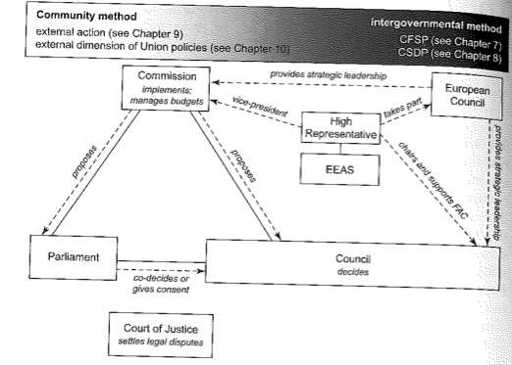
Policy-making frameworks
Both the sectors result ‘contaminated’ by both features.
Notes:
First pillar: supranational quasi-federal practices: the Commission has the monopoly of initiative; legislative measures are adopted through bicameral procedures, QMV in the Council, and the ECJ recurring to full powers.
Second pillar: intergovernmental style of decision-making: less interference from supranational institutions, the practice of consensus for the most issues, and a case-by-case concerted method, rather than a legal framework for decisions.
Both the sectors result ‘contaminated’ by both features.

Slide 16
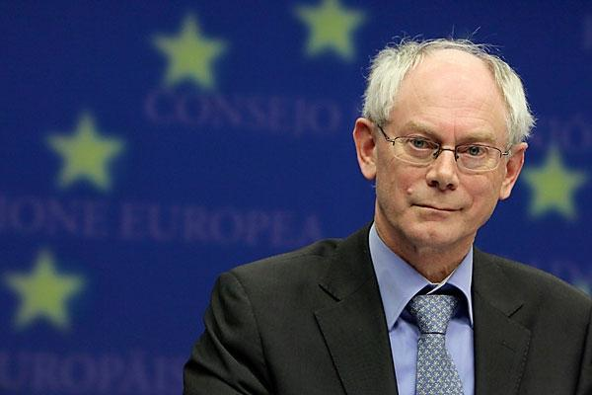
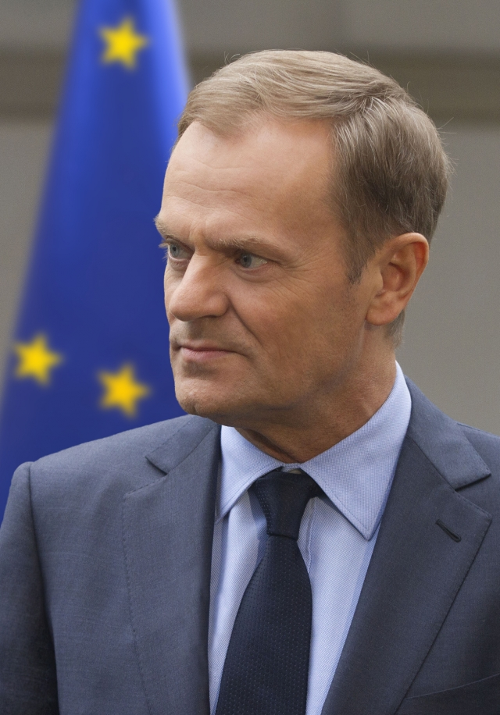
EU Council
= Heads of State and Government + President of the European Council (chair) + HR + President of the European Commission
“Shall provide the Union with the necessary impetus for its development and shall define the general political directions and priorities thereof” (ART. 9B TEU(L))
“Shall identify the Union’s strategic interests, determine the objectives of and define general guidelines for the common foreign and security policy … It shall adopt the necessary decisions” (Art. 9B TEU(L))

Slide 17
EU Council: Limitations
Formally it meets twice every 6 months: possibility of permanent strategic leadership?
It often confirms or endorses decisions that have been pre-decided by the Council, HR or Commission (changing after the crisis?);
Strategic decisions require political implementation by other institutions.
Additional Agenda-Impetus
HR shall “contribute” (Art. 13A TEU(L))’
Rotating Presidency + individual MS;
European Commission in its policy remit.
Notes:
and is convened by its President
the Council, Commission and HR
As research on the reference to core policy norms in economic governance (McNamara 1998) as well as in the EU’s Common Foreign and Security Policy (CFSP) has shown, this uncertainty not only occurs in crisis situations – when it is clearly most pronounced – but is rooted more fundamentally in the contested nature of these norms (Puetter and Wiener 2007).

Slide 18
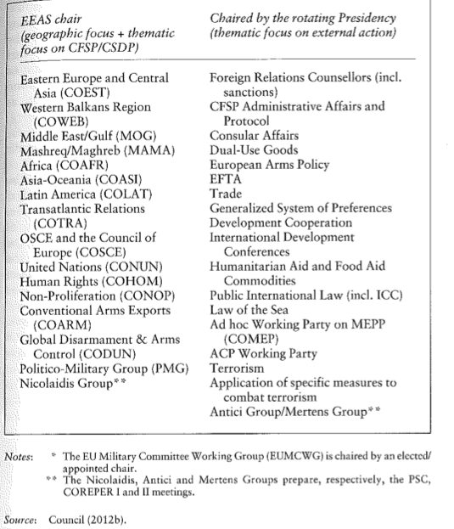
The Council of the EU

Slide 19
Syndicate discussion
Is the current trend towards bilateral and sub-regional cooperation in Europe a threat or an opportunity for CSFP?

Slide 20
The Commission
Proposes policy ideas for the medium-term development of the EU;
Initiates legislation and arbitrates in the legislative process;
Represents the EU in bilateral and multilateral trade negotiations;
Issues rules and regulations;
Manages the EU budget; and
Scrutinizes the implementation of Treaty articles and secondary legislation.

Slide 21
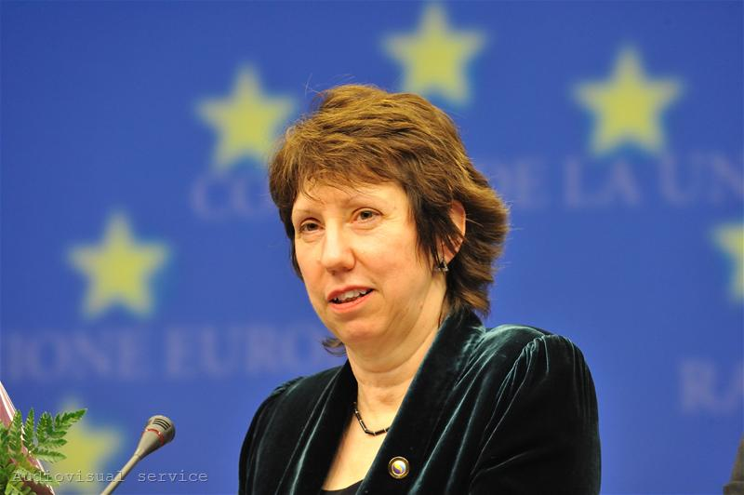
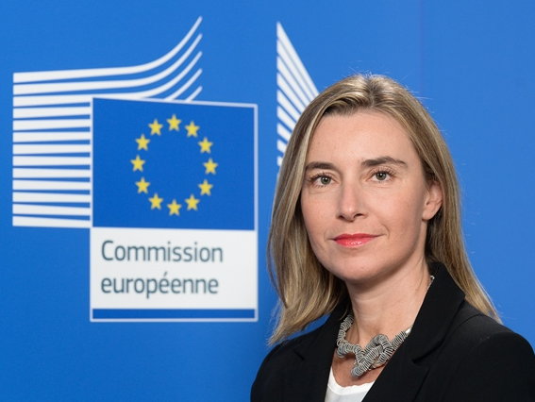
HR/VP
1999-2009: HR: J. Solana; Commissioner for External Relations: Patten; Ferrero-Waldner;
Lisbon treaty: merger of the two roles.
Several roles: Commission VP;
President of the FAC: (Chairing of the meetings, Preparing drafts of decisions);
Head of theEEAS;
Head of the EU Delegations;
Responsible of the EU Special Representatives – coordination and funding.
Notes:
(11: promoting EU policies and interests; playing an active role in efforts to consolidate peace, stability and rule of law.

Slide 22
High Representative/Vice President
Chair Vice-President
FAC COMM External Action
Assisted by the EEAS
Shall Conduct the CFSP/CSDP
Shall ensure the consistency of the EU’s external action, be responsible within the COMM for responsibilities incumbent in EA
conduct political dialogue with third parties and express the EU’s position in Int. Conferences
DG DEVCO
DG Trade
DG NEAR
DG ECHO
Coordinate action in IGOs & Int. Conferences
Joint proposal COMM/HP for economic sanctions
Coordinate civ./mil aspects of CSDP
Direct and Coordinate the “Union Delegations”
Notes:
Duke 2009 – Revised

Slide 23
The EEAS (Art. 27.3 TEU)
Supports the HR in fulfilling her mandate to conduct the "CFSP” and ensures the consistency of the EU's external action.
Supports the HR in her capacity as President of the FAC.
Supports the HR in her capacity as VP of the Commission, for responsibilities incumbent on the Commission in external relations and for coordinating other aspects of the Union's external action.
Notes:
, without prejudice to the normal tasks of the General Secretariat of the Council
, without prejudice to the normal tasks of the Commission services.

Slide 24
Composition of the EEAS
The staff of the EEAS comprises officials of the Commission & Council Secretariat and MSs’ diplomats appointed as temporary agents & SNEs.
The EEAS staff comprises a meaningful presence of nationals from all the MSs. […]
The staff of the EEAS shall carry out their duties and conduct themselves solely with the interests of the EU in mind.
A step back or a step forward towards the creation of an esprit de corps?
Notes:
(Council Decision 8029/10)
Seconded National Experts
Possible clash of diplomatic cultures?

Slide 25
Commission
European Council
EEAS
HR/VP for foreign and security policy
General Affairs Council
Chair: Rotating Presidency
Foreign Affairs Council
Chair: HR/VP
COM
DGs
Other Councils
COREPER
Chair: Rotating Presidency
COPS/CSP
Chair EEAS
WG
Trade
Chair: Presidency
WG
DEV
Chair: Presidency
WG
Horizontal
Chair: Presidency
WG
CFSP
Chair EEAS
WG
CFSP
Chair EEAS
WG
CSDP
Chair EEAS

Slide 26
Syndicate discussion
Define/Unpack the idea of EU FP as “Single in a name, dual in policy-making; multiple in nature”
(Keukeleire and Delreux, 2014: 61)

Slide 27
Additional complications
Agreements can have several legal bases (e.g. trade and environment);
Most agreements are “mixed agreements”: agreements also subject to national ratification processes.
Dual representation: who represents the EU in international fora?
For former ‘first pillar’ competences, the Commission and the MS’ representative holding the rotating presidency.

Slide 28
Consistency
Horizontal inconsistency – lack of consistency between policies formulated across the EU’s policy making machinery (e.g. energy policy and HR);
Institutional inconsistency –among different sites of elaboration of external policy (e.g. EEAS and the Commission);
Vertical Inconsistency – between policies agreed at the EU level and pursued by the MSs.
Interstate inconsistency – among the MSs’ national foreign policies.

Slide 29
Syndicate discussion
Has European foreign policy been a success or a failure so far?

Slide 30
Conclusions
Constant “politics of reforming”;
Institutional and organizational uncertainty: possibility of overlapping competences; inter-institutional rivalries; policy misfits; contested leadership…
… But room for a stronger foreign policy orientation;
Food for thoughts: can institutional reorganization compensate for the lack of agreements among the Member States?
Notes:
An adventurous journey of a ‘supranational’ system;

