Slide 1
Università di Catania ERASMUS DAYS 2021- 2022 Erasmus and Beyond
The School of Italian Language and Culture of the University of Catania
italstra @unict.it

Slide 2
The School of Italian Language and Culture of the University of Catania
The School of Italian Language and Culture is a Special Teaching Structure of the University of Catania.
www.italstra.unict.it
It was founded in 2016 to promote the historical and advanced knowledge of Italian Language and Culture for foreign students and workers.
The School is located in the Benedictine Monastery, which is the seat of the Department of Humanities

Slide 3
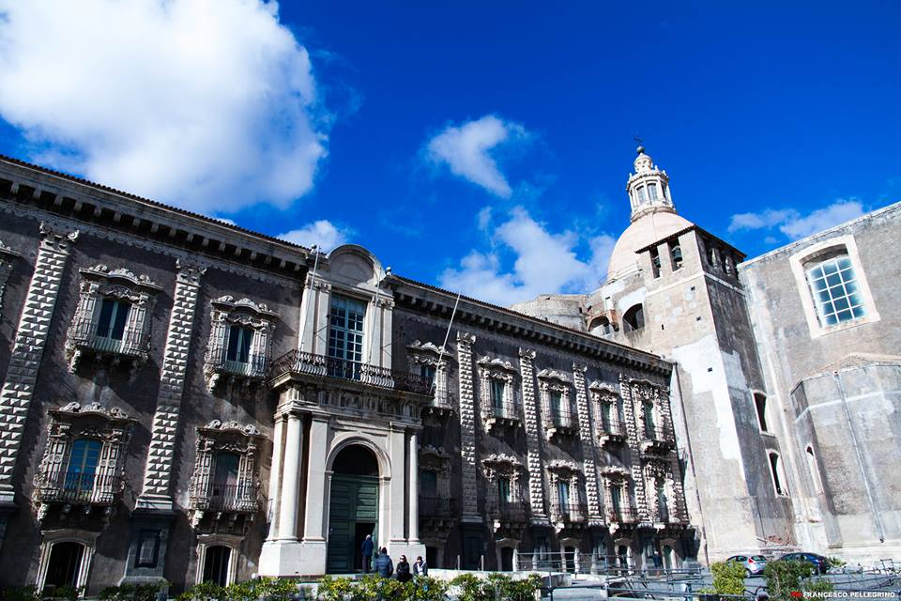

Slide 4
The School of Italian language and Culture at Monastero dei Benedettini Department of Humanities
The Monastery is a unique place that shows Roman ruins, Renaissance walls, Baroque structures.
It is one of the largest Monasteries in Europe.

Slide 5
The Italian Language Courses
The courses of Italian language will be held every semester (October-February and March-June) and are structured along the lines of the Common European Framework of Reference for Languages (CEFR) A1, A2, B1, B2, B2, C1, C2 levels.
Studying Italian Language and Culture in Catania means to live a unique experience in one of the most beautiful cities in Sicily.
Embedded between Mount Etna and the clear sea, Catania is a city of art rich traces of the Greek and Roman culture and the starting point for Baroque routes.
It is famous for the kindness of its inhabitants. It is just the right place to combine learning and having fun.

Slide 6
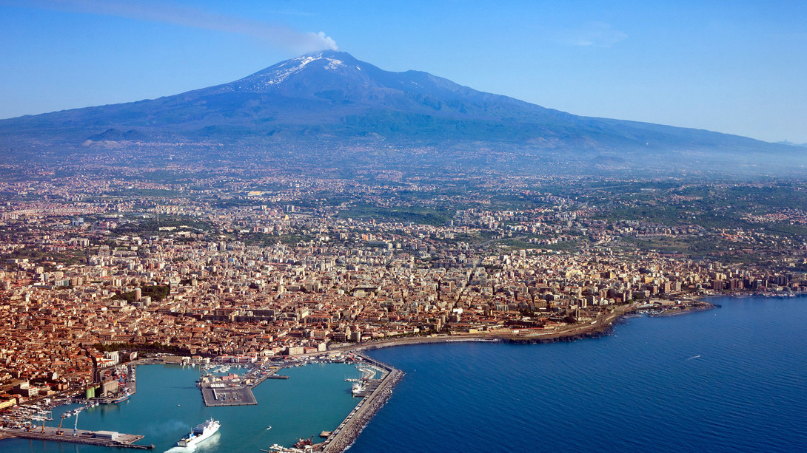
Catania

Slide 7
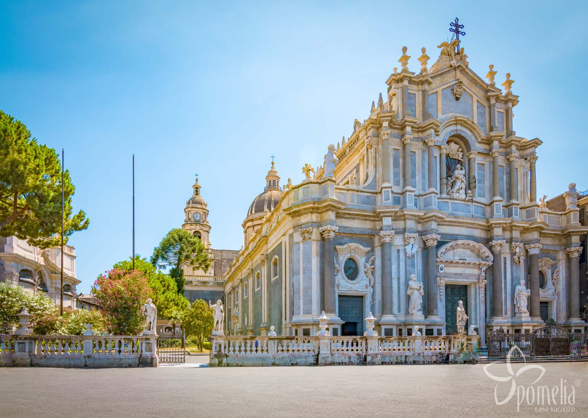
Catania, the Cathedral

Slide 9
Studying Italian at Monastero dei Benedettini Department of Humanities / DISUM

Slide 10
Learning Italian in Catania could be really interesting if you are involved in sectors like tourism or typical food trade. Our School of Italian Language and Culture can offer you
Italian Language and Culture Course (80 hours)
ICON on line learning

Slide 11
From October to February and from March to June you can attend the language courses for your language level
The courses of Italian language, held by the School in two semesters (October-February and March-June), are structured along the lines of the Common European Framework of Reference for Languages (CEFR) and are separated into beginners, intermediate, and advanced (from A1 to C2 level).

Slide 12
The Course consists of 80 hours of lectures in Italian, 20 hours of laboratory activities with the collaboration of trainees who study in Department of Humanities
The Italian Courses are free of any charge for Erasmus Students studying at the University of Catania.
These Courses lead to a Certification, CILS-Certificato di italiano come lingua straniera, in cooperation with our partner University, Università per stranieri di Siena. It can be used for all business requirements.
Each Course gives you 10 CFU and it gives you the real opportunity to speak, read and write Italian in advanced contexts, in your job or scientific activities.

Slide 13
You can also improve your Italian in e-learning mode.
ICoN - Italian Culture on the Net - is a University Consortium composed of nineteen Italian universities operating in agreement with the Italian Ministry of Foreign Affairs.
From1999 ICoN has the aim to promote and disseminate the language and culture of Italy all over the world through e-learning technologies and specific educational initiatives.
You will be given an access code to e-learning Italian Courses

Slide 14
Italian language entry test for Erasmus students. Where:
Saturday October 23rd 2021 from 10:00 a.m. to 12.00 a.m.
at the Auditorium "Giancarlo De Carlo" of the Benedictine Monastery (Department of Humanities - Piazza Dante, 32) an Italian language entry test for Erasmus students will take place.
Department of Humanities
Benedictine Monastery
Piazza Dante 32
95124 Catania
Italy
E-mail: italstra@unict.it

Slide 15
Department of Humanities, Benedictine Monastery, Piazza Dante 32, Catania (Italy)
Email: italstra@unict.it

