Slide 1
EUMedEA CRASH COURSE
UNACCOMPANIED CHILDREN IN EUROPE:
IS THE EU UP TO THE CHALLENGE?
Susana Sanz Caballero
Jean Monnet Chair, University CEU Cardenal Herrera

Slide 2
“We must ensure that all children, particularly those without paternal care, receive international protection and are safe from those who violate their rights and deprive them of their childhood. Ultimately, it should be remembered that children, no matter their status, are children after all and should be treated as such”.
Constantinos Manolopoulos
Interim Director, EU Fundamental Rights Agency

Slide 3
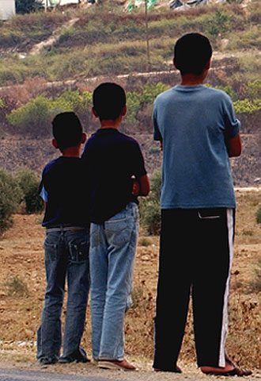
Asylum-seeking children and children refuges are among the most vulnerable groups
Due to the increasing flux, the EU is applying neither int’l nor EU norms correctly
We do not know the exact dimension of the problem

Slide 4
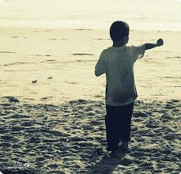
Reasons for children fleeing away
War
Terrorism
Hunger
Human trafficking
Poverty
Drought
Climate change
Catastrophes
Domestic violence
Underdevelopment
Siren calls from mafias & local media

Slide 5
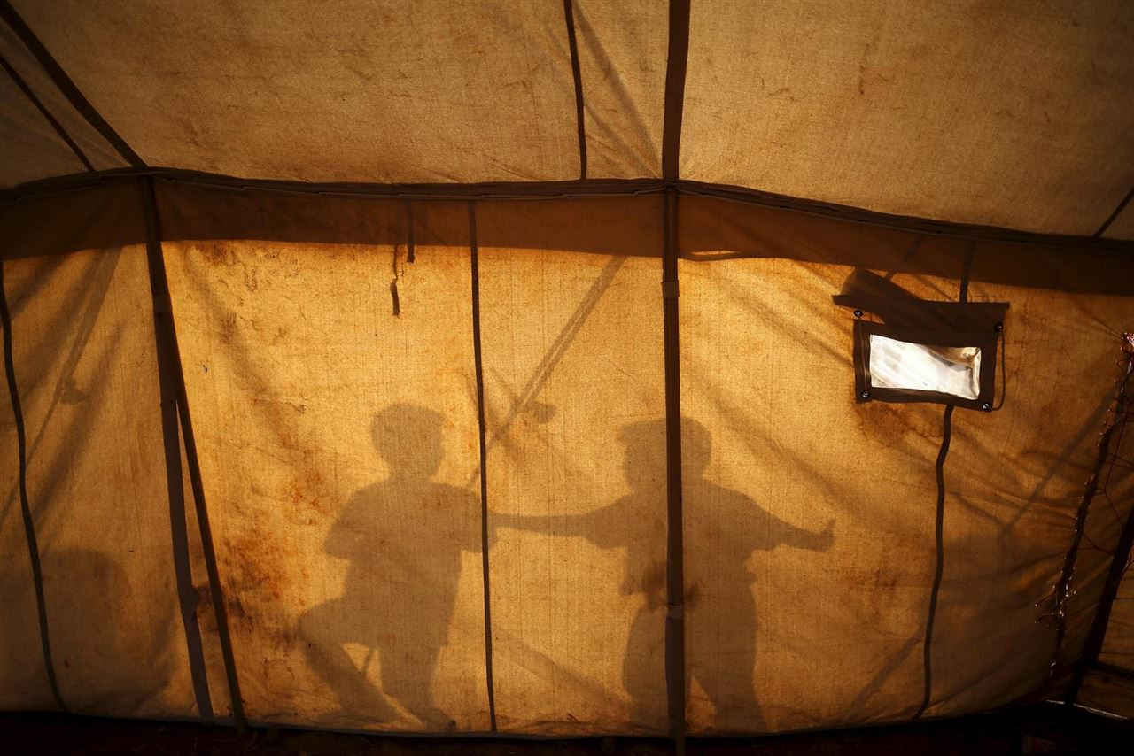
Some practices… not to be followed
Greece
UK
Spain and Malte
Art. 18 CRC
Art. 30 Directive on the conditions governing eligibility for refugee status or international protection
Art. 19 Directive laying down standards for the reception of applicants for international protection

Slide 6
(scarce) legal framework
The Convention on the Rights of the Child does not include any provision on the protection of migrant children/asylum-seekers’ children. However, it includes a provision about the best interets of the child
Neither the ECHR does speak about children
Article 24 CFREU repeats the idea of protecting children and about their best interests
General Observations n. 6 and 14 of the Commitee on the Rights of the Child
Stockholm program: need to take systematically children rights into account

Slide 7
Best interests of the child
meaning
Current EU problems
Undefined legal concept
The BIC depends on the specific circumstances of each child
The BIC is related to the enjoyment by the child of all his/her rights
There is no EU global and clear system of protection of unaccompanied children
We apply collective solutions
Some EU states have been condemned:
Popov/France
Mulanzila Mayeka/Belg

Slide 8
Several tools of the ue
Action plan 2010-2014 for non accompanied children
Directive on the asylum procedure (art. 25)
Directive on the conditions governing eligibility for refugee status or international protection (art.
Directive laying down standards for the reception of applicants for international protection (art. 19)
Directive on the provision of temporary protection in the event of mass influx (art. 13 and 16),
Dublin Regulation III (Art. 6 and 8),
Directive on family reunification (art. 10),
Return directive (art. 10 )
Directive on the prevention and fight against trafficking of persons (art. 16),
Directive against sexual abuse and exploitation of children (art . 20).
Directive on victims of crime (art. 24)

Slide 9
Refugee law
Convention on the status of refugees:
Today, the UNHCR says:
Concluded in 1951
Centred in adult men
Cold war context
The concept has not changed so far
The definition of refugee should include children
Children are autonomous beings
Children can apply for asylum on their own
The forms of persecution of children can be different

Slide 10
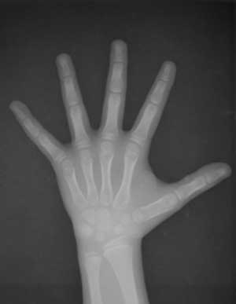
Unaccompanied children face major problems:
Unregistered
Invasive methods to determine age
Risk of repatriation
Difficulties of integration
Legal representation
Discrimination

Slide 11
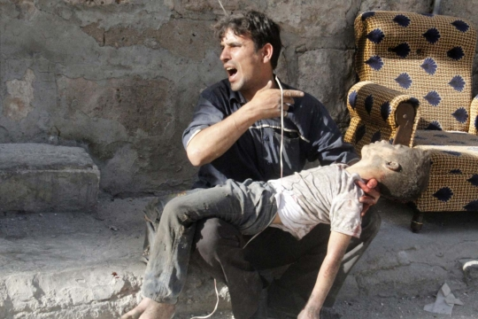
Forms of children’ persecution
Fear of enrolment in armed conflict
Victims of traffick
Child labor
Female mutilation
Domestic violence
Street children
Children with AIDS
Early marriage
Victims of honor crimes
Slavery

Slide 12
Proposals (1 of 7)
Need to identify and register all children
Need to create a centralized European data-base
Need to reinforce the staff in charge of registration
Deployment on the ground of teams of social workers, legal councellors, translators…
European program of family reunification
More generous provisions on family reunification
The launch of a program of family search
Verification that adults accompanying children are not traffickers
Right of the child to file individual asylum applications

Slide 13
Proposals (2 of 7)
Need to reassure the child that finding his/her family does not mean repatriation
Need to inform children about their right to asylum
Distribution of child-friendly brochures
Need to establish programs of integration in host
Need to establish rehabilitation programs at origin
In case of return, need of safety for the child
Installation of reception centers of the UNHCR or UNICEF at the states of origin
Need to promote peace and development

Slide 14
PROPOSALS (3 OF 7)
Access to asylum procedure as a priority for children
Resolution of the procedure in 6 months (max).
Providing more training to staff. And more staff!
Providing more information about mechanisms against abuses
Children pointing abuses, should not be penalized
Increasing funds for the protection of children’ rights
Finishing with the divergences in national policies
Uniformizing the standard of protection, infrastructures, services…
Assuring the same rights for migrant children and children that are nationals of the state

Slide 15
PROPOSALS (4 OF 7)
Health examination on the spot
Post-trauma psychological councelling
Assignation of a legal guardian to each child
Definition at EU level of legal guardian’s fonctions
Inform the child about the rol of the legal guardian
Legal guardian must be present in all procedures concerning the child
Child and guardian must be present and listened if the child is going to be returned
Need of regular contacts between guardian and child
Possibility of replacement of guardian

Slide 16
Proposals (5 of 7)
Assignation of a social worker to children travelling with their families
Reinforce the protection of non asylum-seeker children
Absolute prohibition of placing migrant children in detention just for not producing the correct documents
Deprivation of liberty adjusted to the BIC in case of children in conflict with the law
Foster families from the same culture (country?)
Foster families should be monitored
For teenagers, semi-independent accomodation

Slide 17
Proposals (6 of 7)
Schooling A.S.A.P
No schooling segregation
Language courses for children
Language courses for teachers
Homework supplementary support
Vocational training for the older children
Better an easier access to the work market
Facilitating the contact between children from the same country
Involvement of local and regional authorities
Support of the European Refugee Fund

Slide 18
Proposals (7 of 7)
Benefit of doubt regarding determination of age
Possibility of appeal against determination of age
Possibility of revising decisions taken about children
Lasting solutions for children not applying for asylum
Using the ECtHR’s mechanism of provisional measures
Temporary collective protection of children
2010-2014 EU Action plan should be renewed
Drafting a common and comprehensive European manual about the protection of unaccompanied children
European supported telephone number

Slide 19
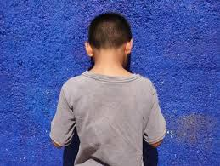
Protecting unaccompanied children in eu
Difficult but necessary
Placing children at the center of policies as a duty
The number of unaccompanied children will continue growing up in the future
1 of each 3 people arriving in Europe is a child
Undocumented children rest invisible

Slide 20
Some eu countries…
Reject the entry of non-asylum seekers, children included
Only accept a quota of asylum seekers per day
Have concluded agreements with transit states to return individuals, children included
Violate children’ human rights with the way they determine the child’s age
Do not register children
Do not assign a legal guardian
Do not inform children about their right to apply for asylum
Generally retain children
Are very restrictive granting asylum

Slide 21
General measures to be taken:
Drafting a European code of asylum to replace all the current directives and regulations
A uniform (and generous) European of asylum
Settlement of a European asylum authority with binding powers and able to coordinate and give orders to national agencies
European arbitration body?
European court of asylum within the structure of the CJEU?
Possibility of presenting applications for asylum extraterritorially
Issuing humanitarian visas
Applying provisional measures before the ECtHR
Offering a reasonable entry policy for economic migrants?

Slide 22
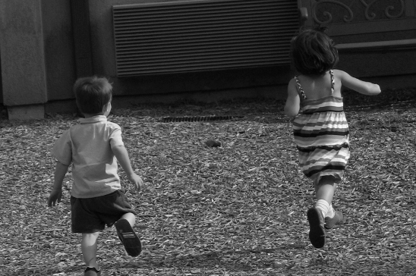
conclusions
In the absence of a robust EU asylum system, MS apply their own policies
There are both best and worst national practices
Need to adopt a European uniform and binding policy concerning unaccompanied children followed by a harmonization og nacional practices
Need of a more supranational policy
Children are not ilegal, they are not irregular, they are not clandestine. Children are children.

